Slide 1
Term Project: Address Book with SQLite
Robert S.

Slide 2
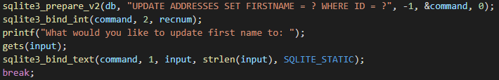
Executing SQLite statements
Sqlite3_prepare_v2()
Sqlite3_bind
Sqlite3_step()
Sqlite Constants SQLITE_OK, SQLITE_ROW, SQLITE_DONE

Slide 3
Major Roadblocks
Sqlite3_prepare cannot bind wildcards to be the column names
Sqlite3_prepare will fail if the SQL statement would not run in the database, even if the syntax is correct (Column name is incorrect)

Slide 4
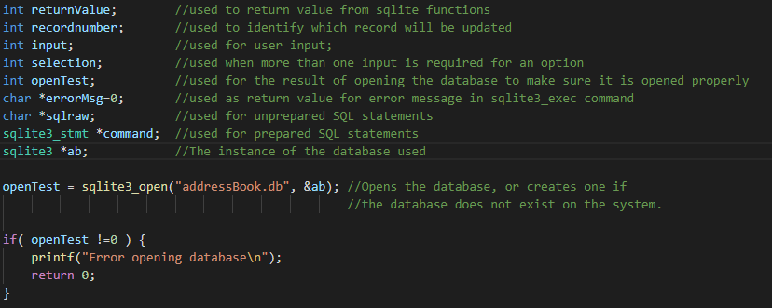
Main function: Variable Declarations and Opening the sqlite database file

Slide 5
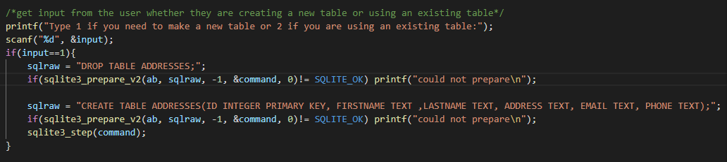
Main Function: Create new table or using existing table.

Slide 6
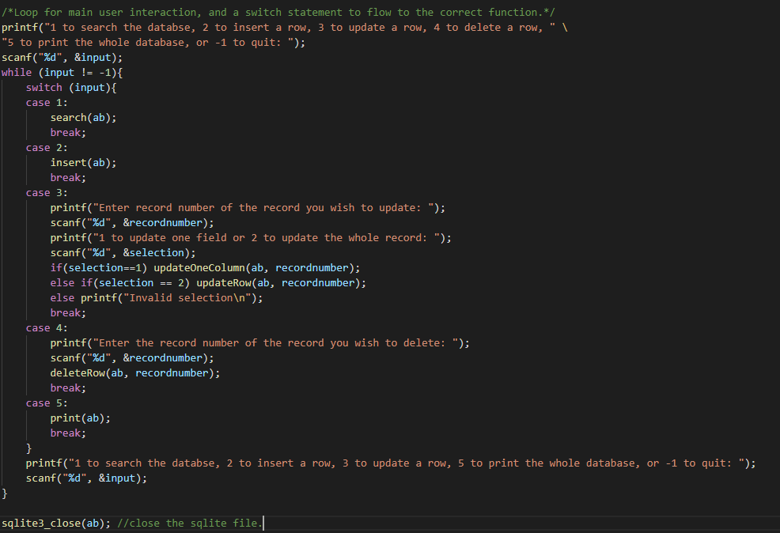
Main function: User input loop and file close

Slide 7
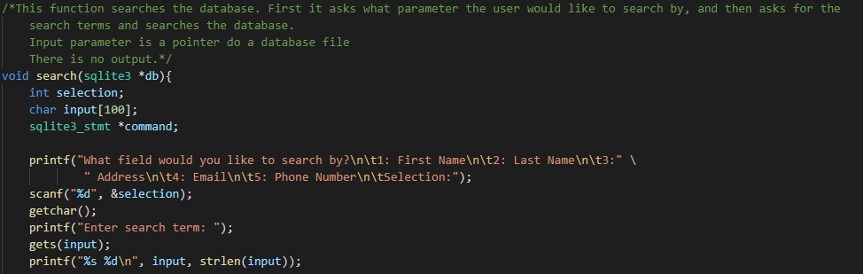
Search function

Slide 8
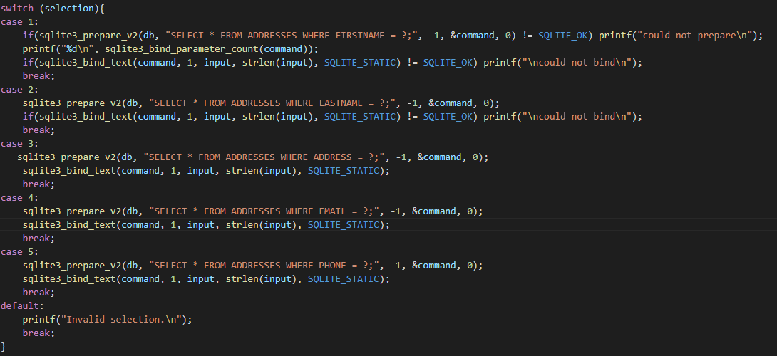
Search Function

Slide 9
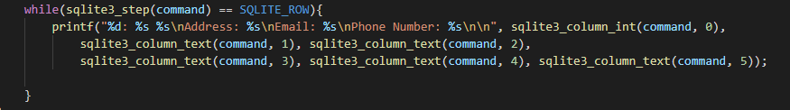
Search Function

Slide 10
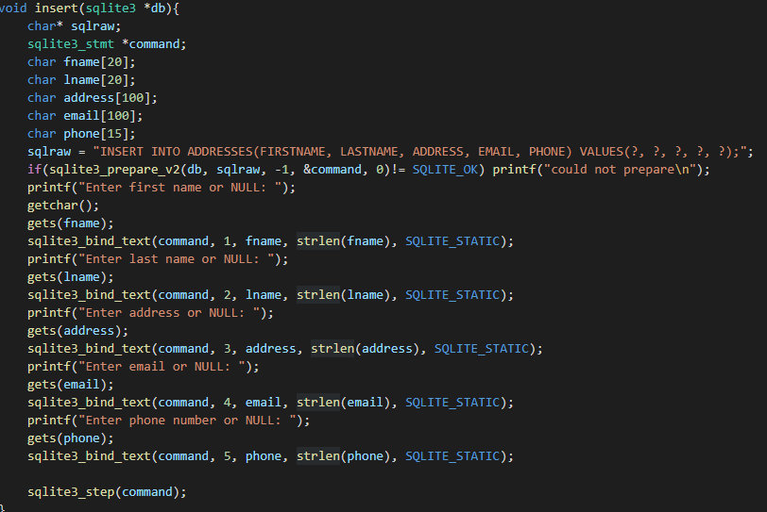
Insert function

Slide 11
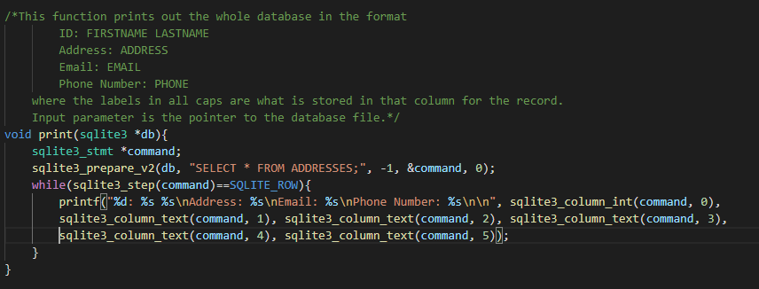
Print function

Slide 12
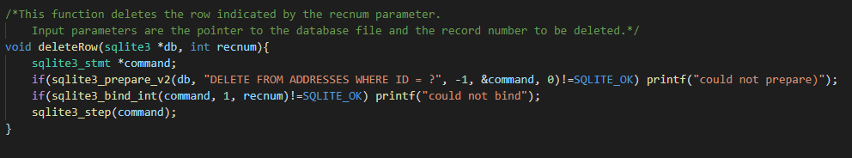
Delete function

Slide 13
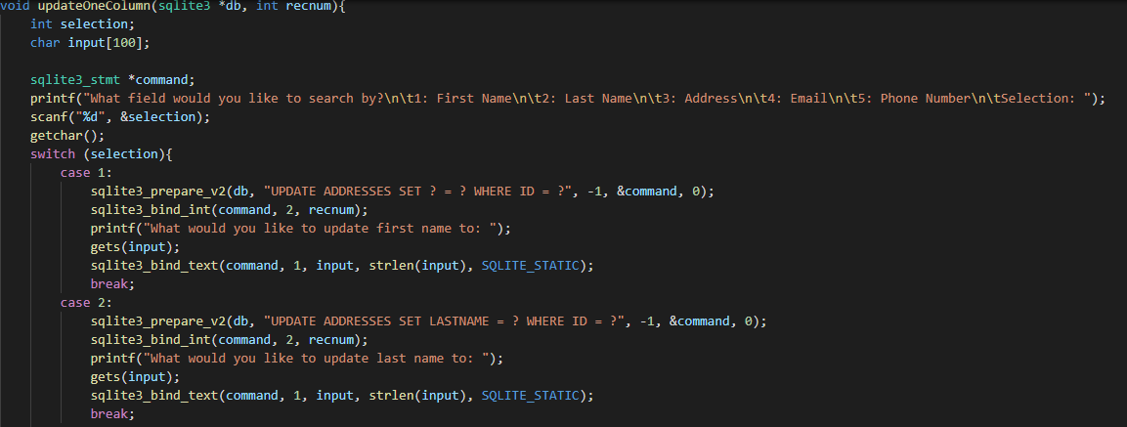
Updating one field in a record

Slide 14
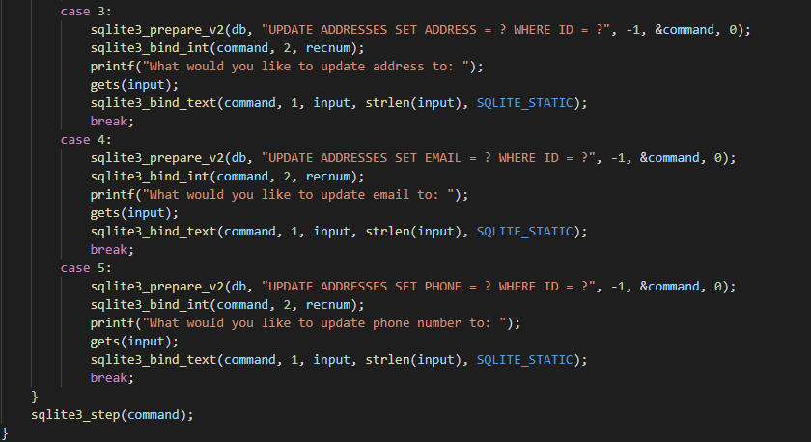
Updating one field in a record

Slide 15
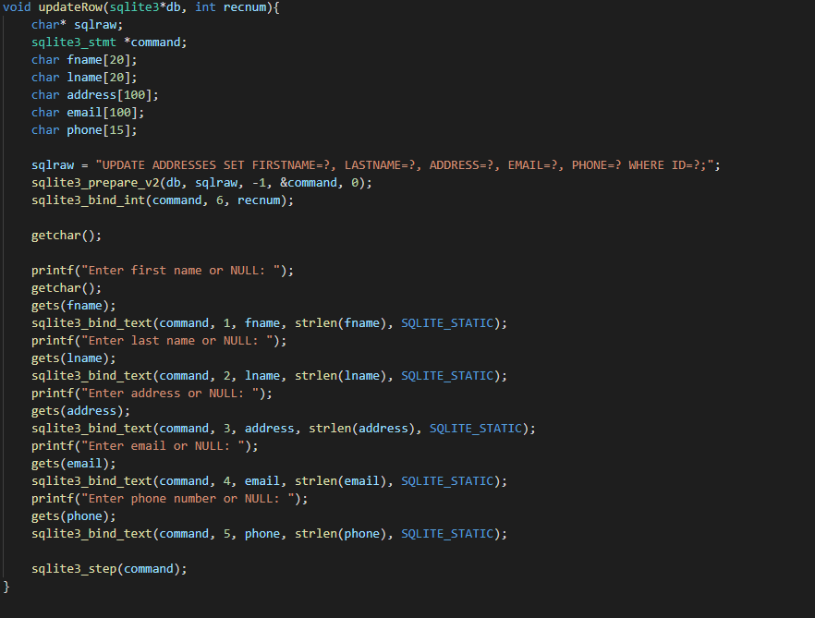
Updating every field in a record

